Slide 1
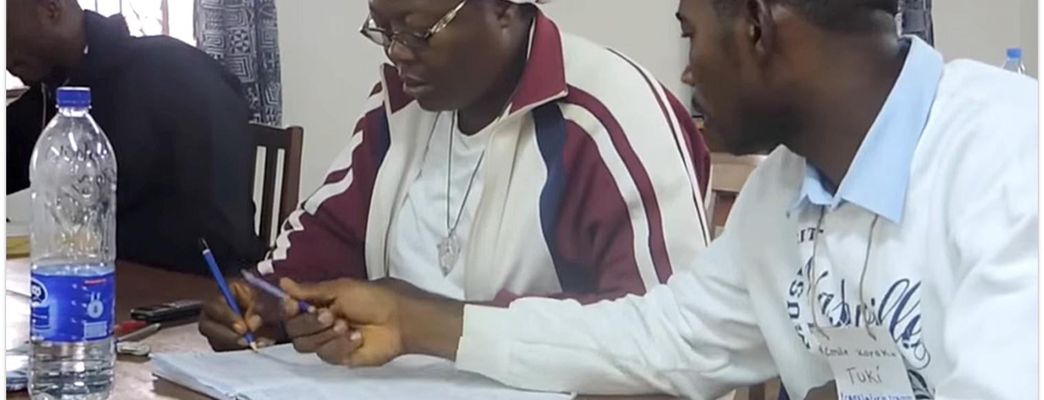
Then Jeremiah called Baruch son of Neriah, and Baruch wrote in a scroll, at Jeremiah's dictation, all the words of Yahweh spoken to him (Jer. 36:4).
All Scripture taken from the English Unlocked Literal Bible (ULB), ©2017, 2022 Wycliffe Associates, Available at https://bibleineverylanguage.org/translations, licensed under the Creative Commons Attribution-ShareAlike 4.0 International License.
The English ULB is based on the unfoldingWord® Literal Text, CC BY-SA 4.0. The original work of the unfoldingWord® Literal Text is available at https://unfoldingword.bible/ult/.
Translation Drafting Steps
COBT 8-Step Translation

Slide 2

COBT 8-Step Translation
many people working together to advance Bible translation globally
assisting the local church worldwide
providing training to the local church—processes, resources, and tools
partnering to get a Bible in Every Language

Slide 3
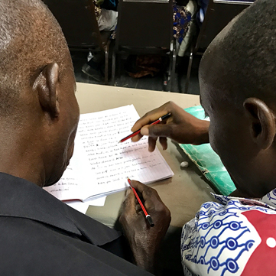

The 8-Step Translation Process
Drafting Steps
Checking Steps
Consume
Verbalize
Chunk
Blind Draft
Self-edit
Peer-edit
Key Word Check
Verse-by-Verse Check

Slide 4
Drafting Steps Defined
1
Consume
Think about what the passage means
How sweet are your words to my taste, yes, sweeter than honey to my mouth!
Psalm 119:103
5–7 minutes

Slide 5
Drafting Steps Defined
2
Verbalize
Summarize the passage to someone in your language
With my mouth I have declared all the righteous decrees that you have revealed.
Psalm 119:13
2–3 minutes

Slide 6

Drafting Steps Defined
3
Chunk
Break the passage down into smaller pieces based on meaning
Open my eyes so that I may see marvelous things in your law.
Psalm 119:18
5-7 minutes
(Usually
1–4 verses)

Slide 7

Drafting Steps Defined
4
Blind Draft
Read chunk, write what you remember
I have stored up your word in my heart so that I might not sin against you. Blessed you are, Yahweh;
teach me your statutes. Psalm 119:11-12
Complete without looking back at source text

Slide 8
Try it
1
2
3
4
Consume
Verbalize
Chunk
Blind Draft
Think about what the passage means
Summarize the passage to someone in your language
Break the passage down into smaller pieces based on meaning
Read chunk, write what you remember
5–7 minutes
2–3 minutes
5-7 minutes
(Usually
1–4 verses)
Complete without looking back at source text

Slide 9
Try it
Are you surprised by what you can do?
What is difficult?
Are you ready for the next steps?

